Slide 1

Big Data Analysis With IBM Cloud Databases
INNOVATION
Sirisha N

Slide 2

Introduction
In today's data-driven world, businesses are increasingly relying on big data analysis to gain insights and make informed decisions. This presentation will explore how advanced machine learning algorithms can revolutionize predictive analytics and anomaly detection.
This Photo by Unknown author is licensed under CC BY.

Slide 3

Abstract
"Unlock the power of innovation in big data analysis with cutting-edge machine learning algorithms. Explore predictive analytics for informed decision-making and anomaly detection to safeguard against unseen risks. Dive into a world of data-driven insights and harness the potential of advanced technology for a brighter, more secure future."

Slide 4

What is Big Data ?
Big data refers to extremely large and complex data sets that cannot be processed by traditional data processing techniques. It requires advanced tools and technologies to store, process, and analyze the data. Big data can come from a variety of sources, including social media, IoT devices, and sensors.
This Photo by Unknown author is licensed under CC BY-NC-ND.

Slide 5
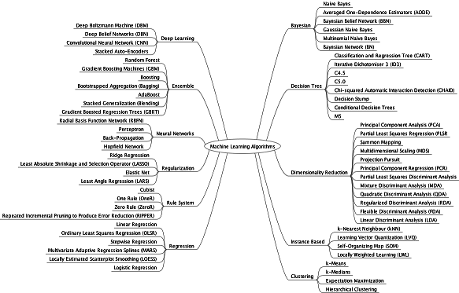
Machine Learning Algorithms
Machine learning algorithms are a type of artificial intelligence that can learn from data and improve over time. They can be used for a variety of tasks, including classification, regression, and clustering. Some popular machine learning algorithms include decision trees, random forests, and neural networks.

Slide 6
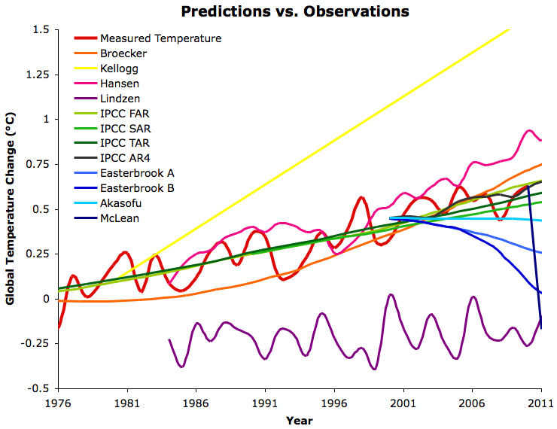
Predictive Analytics
Predictive analytics uses machine learning algorithms to analyze historical data and make predictions about future events. It can be used for a variety of applications, including fraud detection, customer segmentation, and demand forecasting. Predictive analytics can help businesses make more informed decisions and gain a competitive advantage.

Slide 7
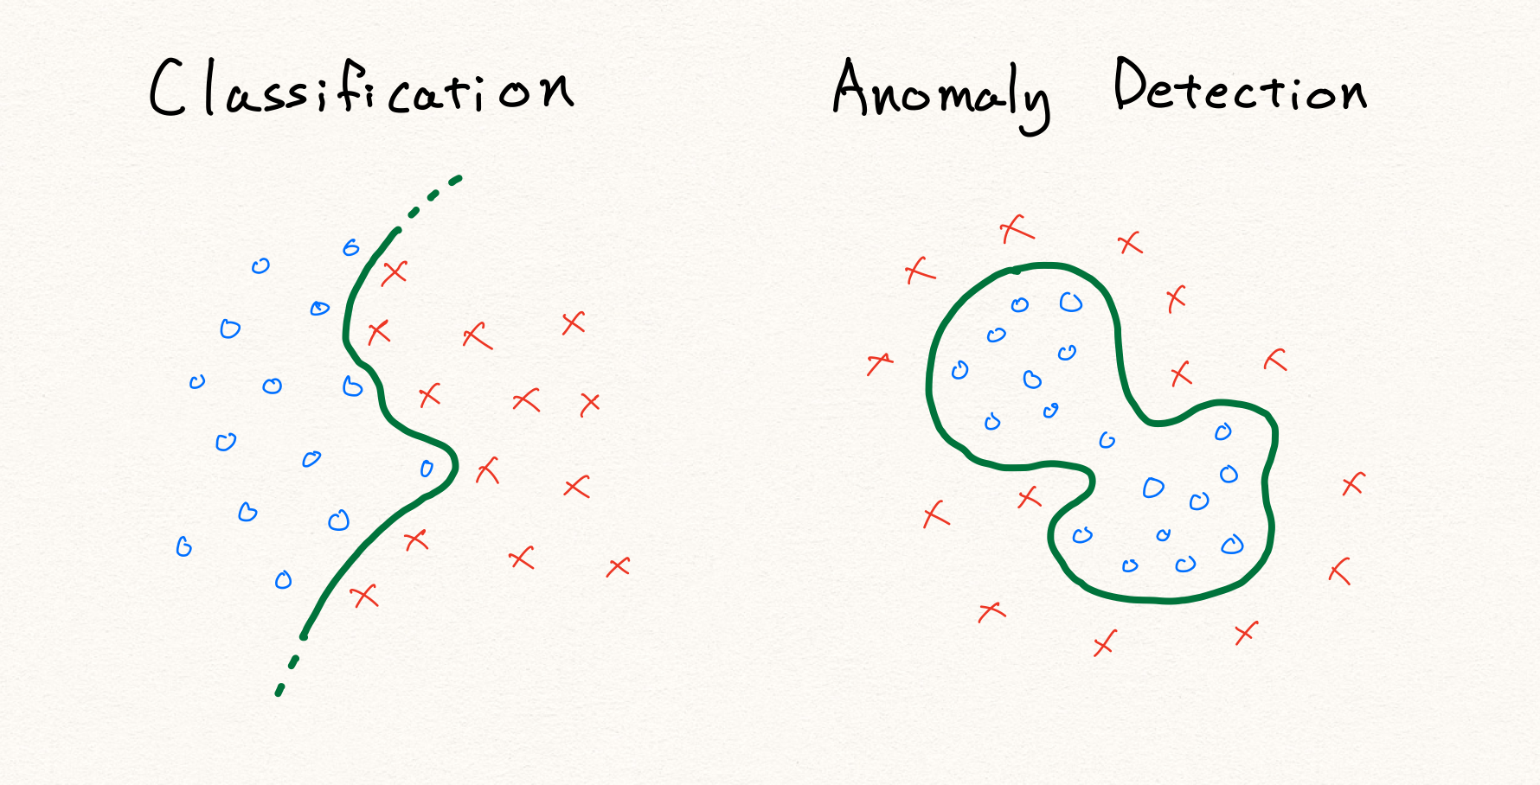
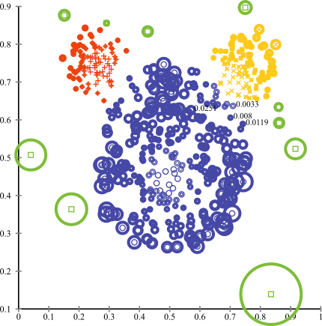
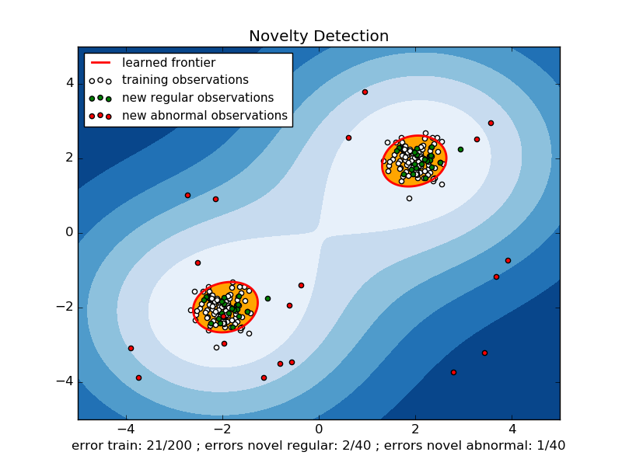
Anomaly Detection
Anomaly detection uses machine learning algorithms to identify unusual patterns or outliers in data. It can be used for a variety of applications, including fraud detection, network security, and equipment failure prediction. Anomaly detection can help businesses detect and prevent potential problems before they occur.

